Slide 1
Updates to RODAN Gamera Interactive Classifier
Minh Anh Nguyen
DDMAL
McGill University
Montreal, Canada
SIMSSA Workshop XVII
Dec 1, 2018

Slide 2
History
Originally a part of Gamera, a framework for document analysis applications by Karl MacMillan, Michael Droettboom, and Ichiro Fujinaga in 2001
Implemented as a RODAN job in 2014 by Andrew Fogarty and extended by Sacha Perry-Fagant and Alex Daigle in 2017
Michael Droettboom, Ichiro Fujinaga, Karl MacMillan, G. Sayeed Choudhury, Tim DiLauro, Mark Patton and Teal Anderson. “Using the Gamera framework for the recognition of cultural heritage materials.” JCDL (2002)
Notes:
Gamera functionalities imported as Rodan jobs
Still in progress
Users provide valuable feedback: issues, enhancements

Slide 3
Interactive Classifier
A web-based tool for classifying symbols
Two-part classification
Manual correction: user gives examples
Automatic correction: machine learns from examples
Notes:
Any symbols: numbers, letters, music notation
In our case: neumes from medieval music

Slide 4


Interactive Classifier in OMR
Document Analysis
Pixel.js
Classification
Interactive Classifier
Pitch
Finding & Lyric Alignment
Online Editor
Neon.js
Notes:
Pixel: neume layer -> connected components
Classify -> pitch finding, rendering

Slide 5
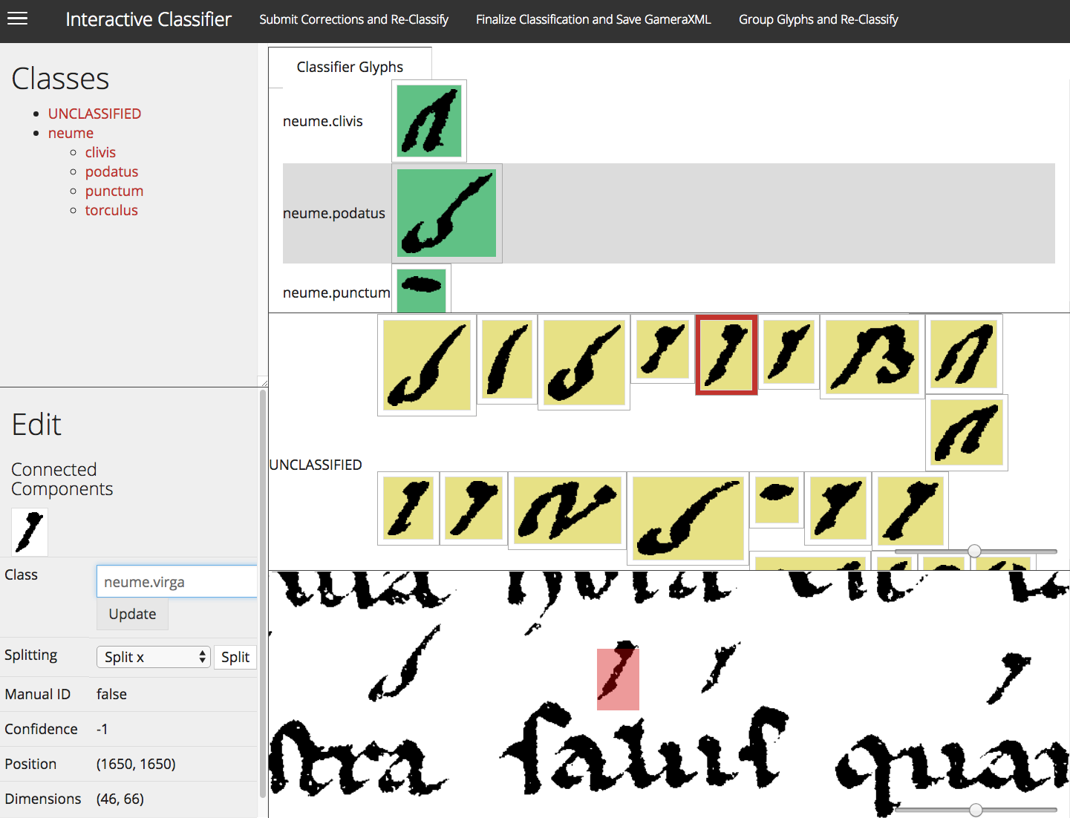
Manual Correction
Assign classes
Delete classes
Rename classes
Group glyphs
Split glyphs
Notes:
Launches a browser window for user
confidence: 1

Slide 6
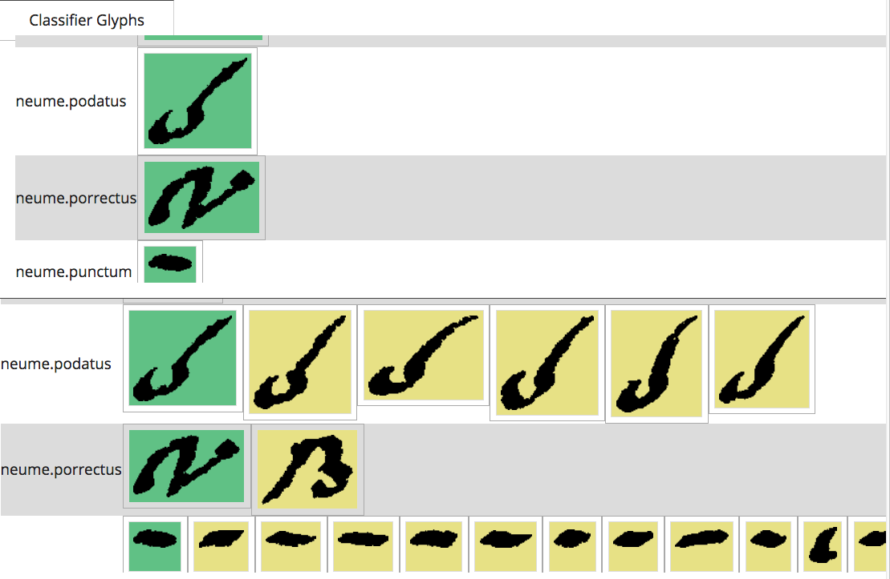
Automatic Correction
Uses the k-nearest neighbors algorithm
Match each glyph to the model with the most similar features
Notes:
Given classifier models, attempt to classify the rest

Slide 7
Advantages Over a Complete Manual Classification
Faster than solely manual classification
Results improve in each iteration
Can classify any type of symbols
Notes:
only need to give 1 or 2 models
all symbols: neumes

Slide 8
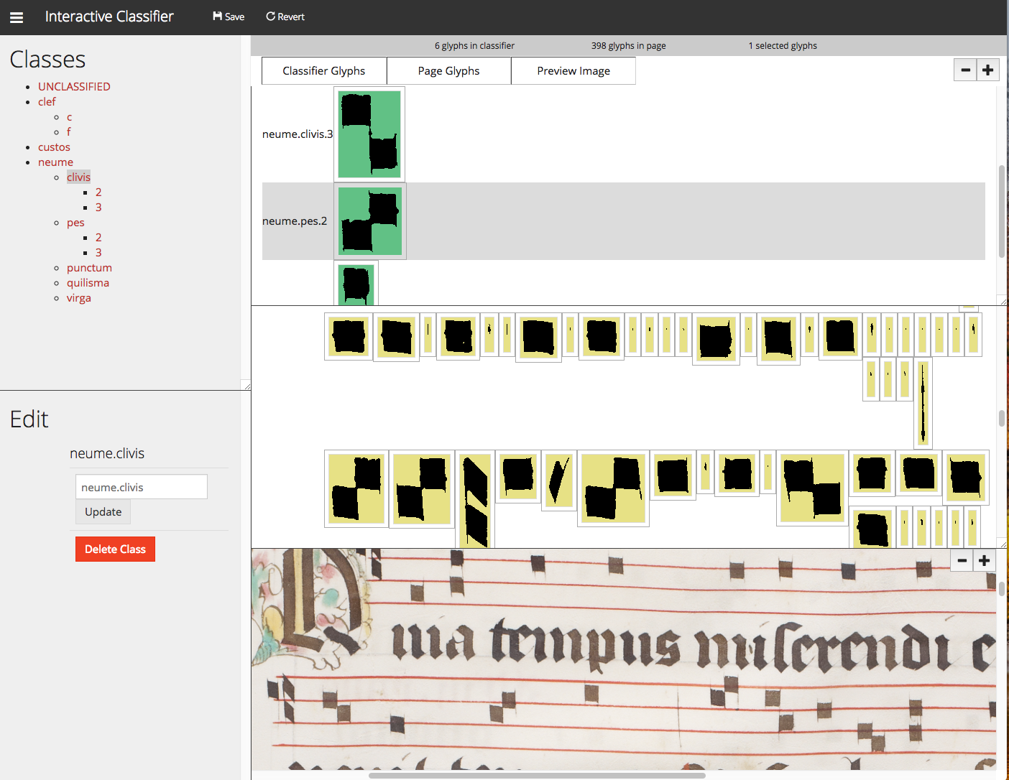
Recent Updates
Delete & rename classes
Import & export classes as a file
Display preview image in color
Save and revert
Optimized zooming actions
Collapsible panes
Resize window
Notes:
No empty or Unclassified class names
Reset the view after events
Delete & rename requested by musicologists

Slide 9
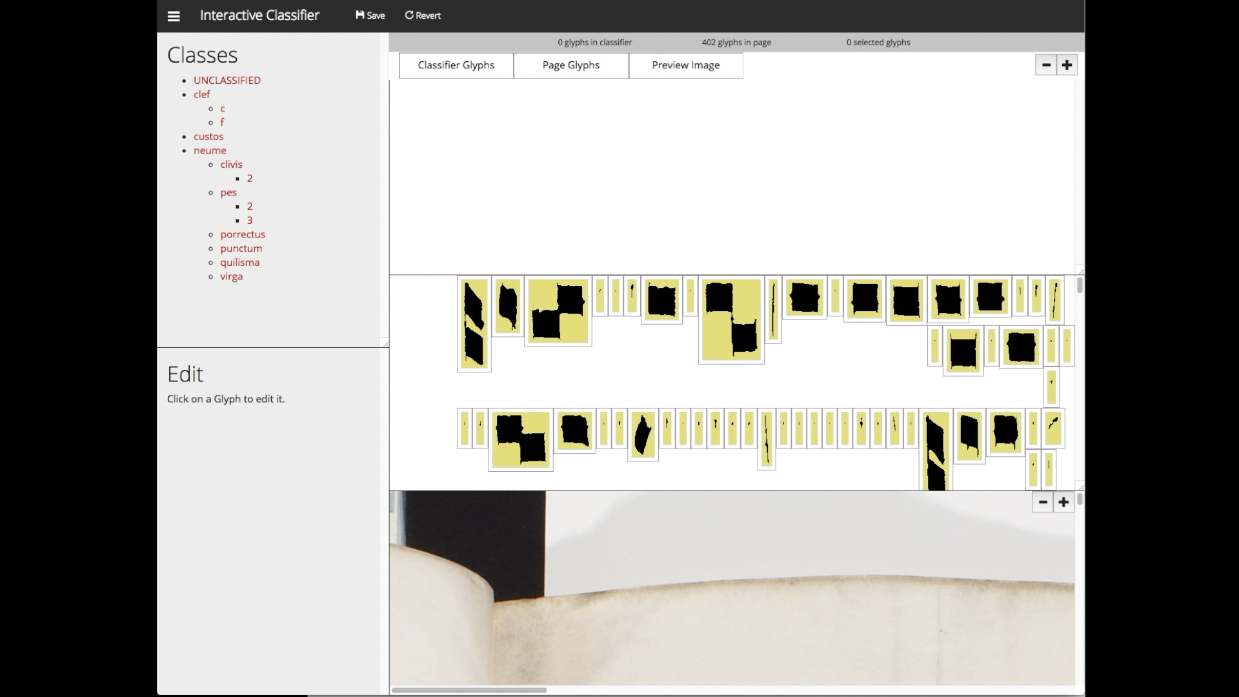
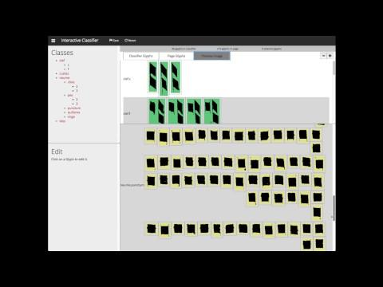
Demo

Slide 10
Future Enhancements
Integrate Diva.js to render the preview image
Increase compatibility with Safari
Implement the classifier optimization as a RODAN job
Implement more unit tests
Notes:
Issue: saving grouped components

Slide 11

Thank you

